Slide 1
DOG BREED IDENTIFICATION
using CONVOLUTIONAL NEURAL NETWORK
Mounica Subramani

Slide 2
INTRODUCTION
The power of Computer vision in AI is beyond our imagination. With neural n/w and deep learning, AI has empowered like never before.
Some fancy sophisticated applications of Computer Vision are Auto tagging of friends in Facebook pictures, gesture recognition, automatic number plate recognition, predicting age of the user through cameras by facial recognition.

Slide 3
PROBLEM STATEMENT
The problem statement is to determine the breed of a dog in an image.
Problem statement is inspired from a Kaggle competition.
This project aims at creating a model which is trained with several images of dogs to classify the same with improved accuracy.
The classification model used is a Convolutional Neural Network.

Slide 4
DATA SOURCE
Dog Breed Identification is a public dataset available on Kaggle
https://www.kaggle.com/miljan/stanford-dogs-dataset-traintest/version/1
The dataset contains 20850 images of dogs in total.
There are 120 breeds in total and each breed has approximately 150 images and corresponding labels.
Train set contains roughly 60% of the total images
Test set contains roughly 40% of the total images

Slide 5
PREVIOUS WORKS
Used SVM regressor to detect a dog’s face in each image and then feeds it to the Convolutional Neural Network
Used pre-trained models to train the data and performed classification using that model.
In our project we use CNN with augmented input data to improve the accuracy of the model.

Slide 6
Why CNN?
Ability to learn optimal features from images. It is known for image analysis (Pattern detection)
Better for colored images with more pixels.
Good accuracy in image recognition problems
Easy training of data
Reduced memory requirement

Slide 7
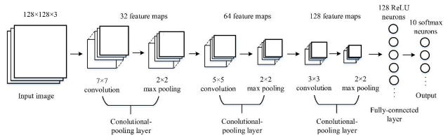
MODEL ARCHITECTURE
Convolutional neural network with 3 layers

Slide 8
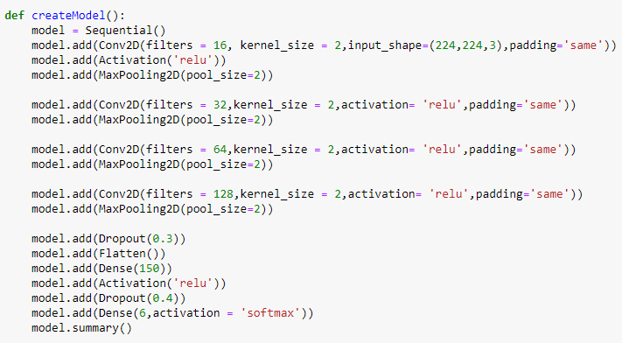
PROGRESS
Created the architecture for our project model
Imported and processed training and testing datasets
Created my own CNN model with 4 convolutional layer and other hidden layers like pooling layer, Fully connected layer and Dropout layer.
Obtained an accuracy of 44.07%.

Slide 9
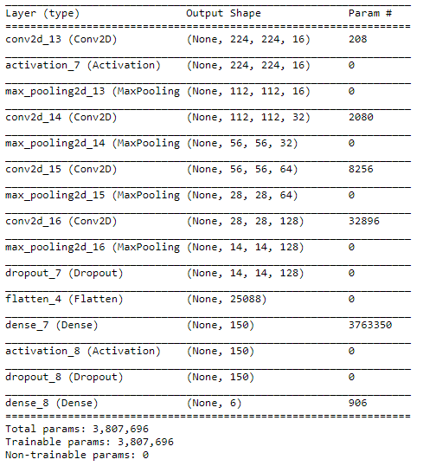
BUILT CNN
We have 4 convolutional layers associated with 4 ReLu activation layers and max pooling layers.
Towards the end, there are two dense layers where one has flatten function with dropout layer and the final one is the fully connected layer with soft max activation function and a drop out layer.

Slide 10
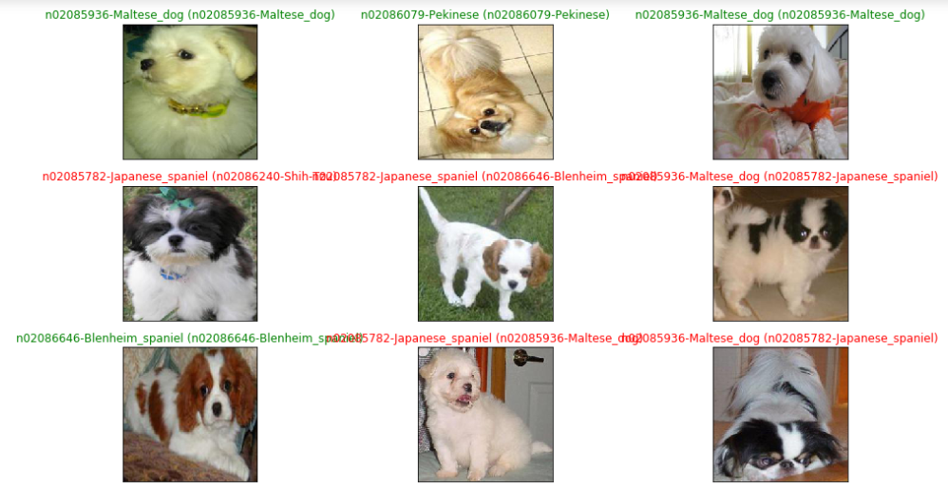
SAMPLE OUTPUT

Slide 11
COMPARISON & FUTURE WORK
Tuning the different hyperparameters of the model to find the best combination that produces better accuracy for our dataset and increase number of layers in the model.
Planning to perform data augmentation techniques like image filipping, rotating, scaling, cropping, translating, and adding gausian noise to the input images and train the model with those images and see what difference they make.
Have an idea of implementing this in an Android environment as a mobile application and test by clicking images of dogs and see if it can classify to some extent.
Compare results with that obtained from pretrained model. (Inception, Xception, VGG16 pre trained models from KERAS library)

